Slide 1
Lecture 6 Data manipulation II
Trevor A. Branch
FISH 552 Introduction to R

Slide 2
Speed testing
system.time() number of seconds to run a command
> temp <- sample(1:100, size=10000000, replace=T)
> system.time( unique(temp) )
user system elapsed
0.40 0.07 0.47
> system.time( temp[!duplicated(temp)] )
user system elapsed
0.96 0.06 1.04
> system.time( temp[which(!duplicated(temp))] )
user system elapsed
0.48 0.08 0.56
> system.time( as.numeric(levels(factor(temp))) )
user system elapsed
8.09 0.19 8.35
10,000,000-long vector of numbers
Slower than using unique
Should be slower, but actually is faster???
MUCH slower

Slide 3
Recommended reading
Data manipulation in R (Phil Spector, 2008)
http://www.springerlink.com/content/t19776/
Chapters 4.1, 8

Slide 4
Combining data sources
We often want to combine two source of data by merging a common variable or observation
e.g. Data measured by different instruments at overlapping times but on different time scales {0,5,10,15,…} and {0,10,20,…}
Such tasks can be difficult to code using only logical operations, rbind(), and cbind(). Instead, merge() combines data very effectively
Explore the help function ?merge

Slide 5
merge()
Two sources of data, station1 and station2 with overlapping time measurements
> station1
time1 data
[1,] 1 -0.069745093
[2,] 2 0.008806333
[3,] 3 -0.289268911
[4,] 4 0.944776136
...
[98,] 98 -1.024886327
[99,] 99 -0.994975640
[100,] 100 -0.673815187
> station2
time2 category
[1,] 0 1
[2,] 5 2
[3,] 10 2
[4,] 15 1
...
[19,] 90 1
[20,] 95 3
[21,] 100 3

Slide 6
Merge using common time
Create a single data set with both variables having common time observations
> merge(station1, station2, by.x="time1",
by.y="time2")
time1 data category
1 5 1.58535005 2
2 10 1.00572430 2
3 15 1.12442383 1
4 20 -1.20569332 1
...
18 90 -0.08973228 1
19 95 0.33275114 3
20 100 -0.67381519 3

Slide 7
Behind the scene of merge()
The merge() function relies on other R functions that can be used for data manipulation
Finding common elements in vectors: intersect()
> intersect(1:10, 7:20)
[1] 7 8 9 10
Matching positions of common elements in vectors
match(x, table, nomatch=NA)
> match(1:10, c(1,3,5,9))
[1] 1 NA 2 NA 3 NA NA NA 4 NA

Slide 8
Hands-on exercise 1
Write code that returns a TRUE/FALSE vector indicating whether the elements in one vector match (TRUE) any of the elements in the other vector
Use the same two vectors 1:10 and c(1,3,5,9)
Look at the help function for match. Seriously, look at it.
Hint: use the match() function. How can you change the results of match to TRUE/FALSE?

Slide 9
How to store and handle dates
R has a built-in class "Date" to handle data entered as a date in various formats
The as.Date() function allows a variety of input formats through the format = argument
> as.Date("2013/10/15")
[1] "2013-10-15"

Slide 10
Formatting dates in R
If your input dates are not in a standard format, you can add a format string, as follows:
Code | Value
%d | Day of the month (decimal number)
%m | Month (decimal number)
%b | Month (abbreviated)
%B | Month (full name)
%y | Year (two digits)
%Y | Year (four digits)

Slide 11
Using date formats
> as.Date('9/22/1983', format = '%m/%d/%Y')
[1] "1983-09-22"
> as.Date('September 22, 1983',
format = '%B %d, %Y')
[1] "1983-09-22"
> as.Date('22SEP83', format = '%d%b%y')
[1] "1983-09-22"
> as.Date('22sep83', format = '%d%b%y')
[1] "1983-09-22"
Gracefully handles upper/lower case
R function toupper(x) converts to upper case

Slide 12
Extracting date components
Components of dates can easily be extracted, provided the items are of class PosIXt or Date
> weekdays(as.Date("2013/10/15"))
[1] "Tuesday"
> months(as.Date("2013/10/15"))
[1] "October"
> quarters(as.Date("2013/10/15"))
[1] "Q4"
> julian(as.Date("2013/10/15"),
origin=as.Date("2013/01/01"))
[1] 287
attr(,"origin")
[1] "2013-01-01"
Number of days from the start of the year

Slide 13
Sub-daily time scales
Most dates read from instruments have a finer time scale than days (hours, minutes, seconds)
For these, use the POSIXct class in R (and not the Date class)
Default input format the POSIXct class consists of the year, month, day (separated by slashes or dashes), time values may be followed by white space and a time in the form hours:minutes:seconds or hours:minutes:
1983/9/22 23:20:05
If the dates are not in this format, see help on strptime()

Slide 14
Converting to POSIXt
> as.POSIXlt("1983-9-22 23:20:05")
[1] "1983-09-22 23:20:05"
> aDate <- as.POSIXlt("1983-9-22 23:20:05")
> as.POSIXct("1983-9-22 23:20:05")
[1] "1983-09-22 23:20:05 PDT"
> aDate <- as.POSIXct("1983-9-22 23:20:05")
POSIXct includes time zone information

Slide 15
Adding and averaging dates
Many common functions can accept objects of Date class: min(), mean(), max(), ...
The difftime() function computes the difference between two time dates
> mean(c(as.Date("2013/10/15"), as.Date("2010/06/14")))
[1] "2012-02-13"
> max(c(as.Date("2013/10/15"), as.Date("2010/06/15")))
[1] "2013-10-15"
> min(c(as.Date("2013/10/15"), as.Date("2010/06/15")))
[1] "2010-06-15"
> difftime(as.Date("2013/10/15"),as.Date("2010/06/14"))
Time difference of 1219 days

Slide 16
Converting dates to factors
First create a vector of the days of the year
> everyday <- seq(from=as.Date("2013-01-01"),
to=as.Date("2013-12-31"), by="day")
> everyday
[1] "2013-01-01" "2013-01-02" "2013-01-03"...
Then convert to factors
> month <- months(everyday)
> month <- factor(month, levels=unique(month), ordered=TRUE)
> table(month)
month
January February March ...
31 28 31 ...

Slide 17
Hands-on exercise 2
Choose any two dates you like
Save them as two objects in the year-month-date format
Apply R functions to determine
the day of the week
the month
the difference between the two dates

Slide 18
Packages in R
In the homework, you loaded the MASS package
This contains functions and data sets from Venables & Ripley “Modern applied statistics with R”
Packages are a key feature in R, allowing users to benefit from other’s contributions
Before performing any truly arduous programming task, ask yourself whether someone else is likely to have already done that
Search for contributed packages that might already have the features you need

Slide 19
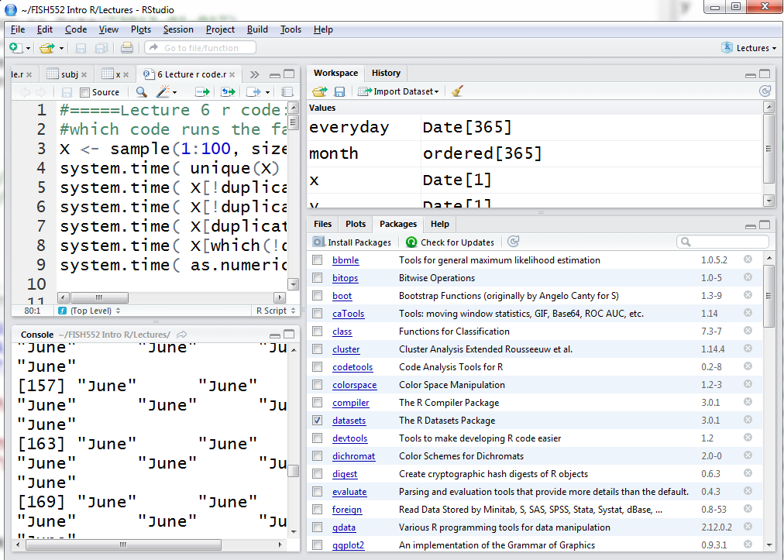
install a new package
already installed packages
Checking the box loads the package
Click on the name of the package to get a list of its functions

Slide 20
Installing and loading packages
Once a package has been installed, it needs to be loaded into R
This can be done by ticking the box next to the package
In your R code, loading is done using one of
library(package) forces package to load every time
require(package) only loads package if not already loaded (I always use this version)
R will return a warning if the package was compiled on a newer R version or if the version of R is incompatible with an older package

Slide 21
Finding packages
Task views http://cran.r-project.org/web/views/ that categorize packages into groups
Ask other people
Active community on Twitter use hashtag #Rstats
Search engine (also try www.rseek.org)
Scientific papers describing new methods, e.g. bathymetry plotting package marmap:
Pante E & Simon-Bouhet B (2013) PLOS ONE 8(9):e73051
Start with the most popular 100 downloaded packages: http://www.r-bloggers.com/top-100-r-packages-for-2013-jan-may/

Slide 22
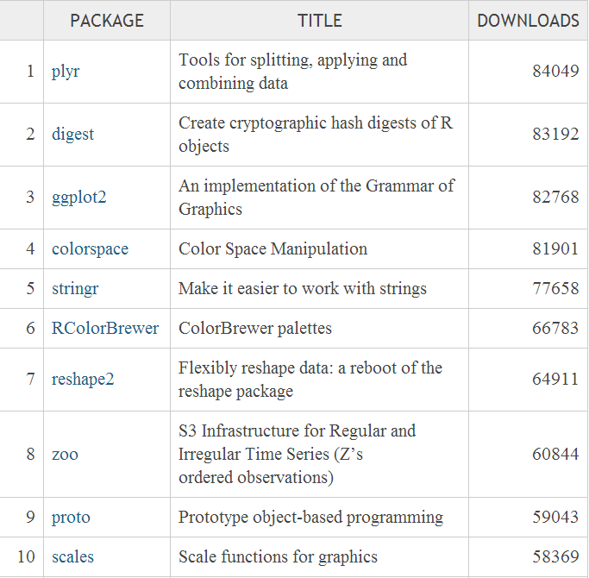
http://www.r-bloggers.com/top-100-r-packages-for-2013-jan-may/

Slide 23
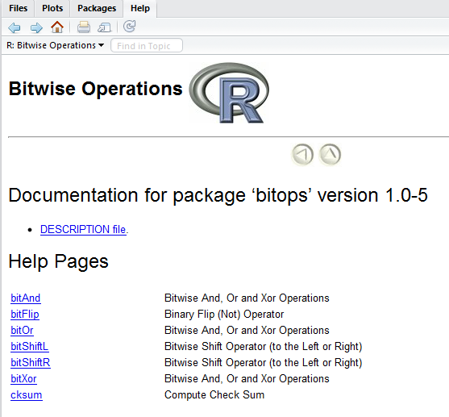
Help on packages
Click on the package for a list
of functions
You can also find vignettes
online, for example
http://cran.r-project.org/web/packages/survival/index.html
Many packages have an overview called a vignette that includes examples of the key functions
> vignette(all=FALSE)
> vignette(all=TRUE)
> vignette("googleVis")
Lists vignettes for installed and attached packages
Lists vignettes for all installed packages
Open a particular vignette

